Slide 1

LALA ENTERPRISE

Slide 2

What is LALA Enterprise?
This company will provide a platform where farmers can get a stable income. Due to which the life of farmers will become more stable.
Farmers are not able to live a stable life due to not having a stable income because they get their income at the end of their farming cycle.

Slide 3
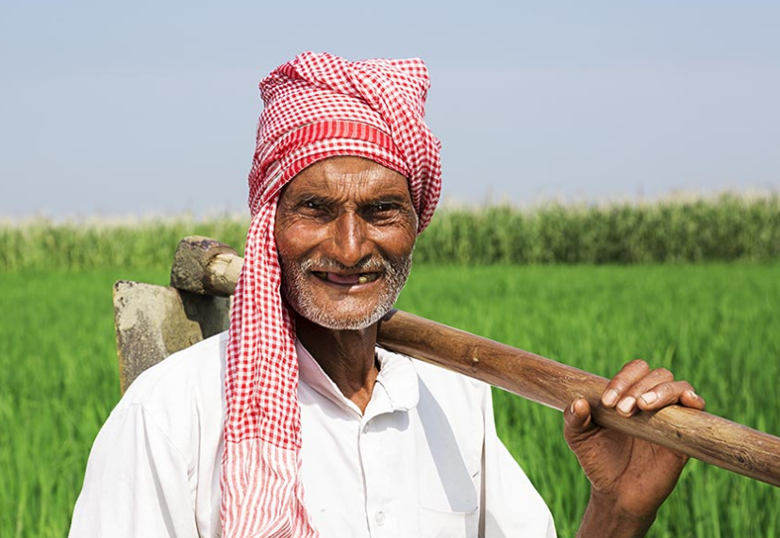

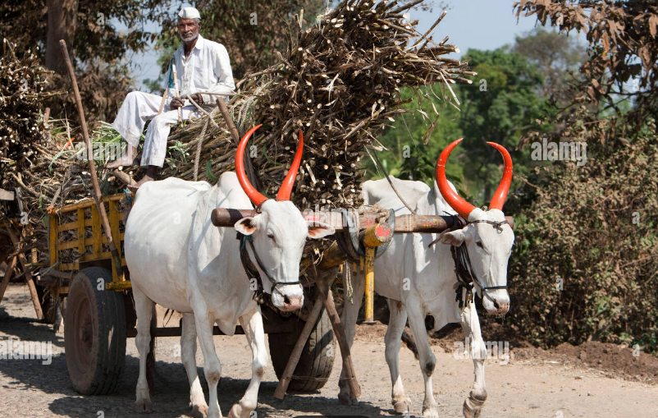
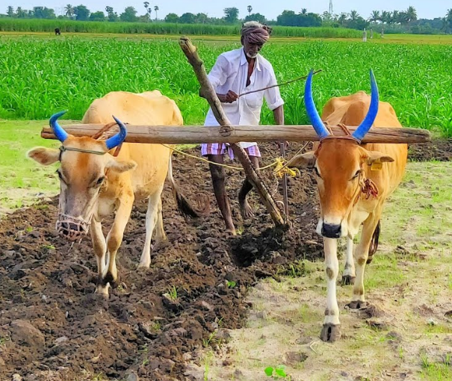


PROBLEMS:
Old Farmer
Soil pollutants
Transportation problems
Less Use of Modern Farming Equipment
Less income
Traditional Crops

Slide 4





CURRENT SYSTEM
MIDDLE-MAN
FARMER
TRANSPORTER
CUSTOMER
SALES MAN

Slide 5

FARMER
MIDDLE-MAN
TRANSPORTER
LALA ENTERPRISE

Slide 6



BENEFITS
STABLE INCOME
Natural Fertilizers
Providing Modern Equipments

Slide 7
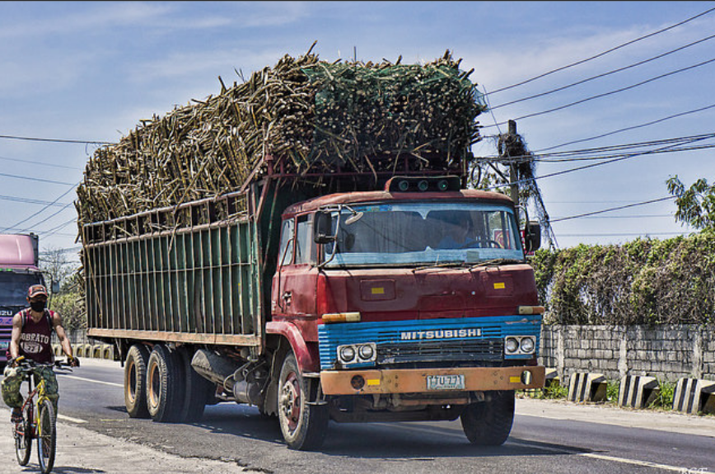
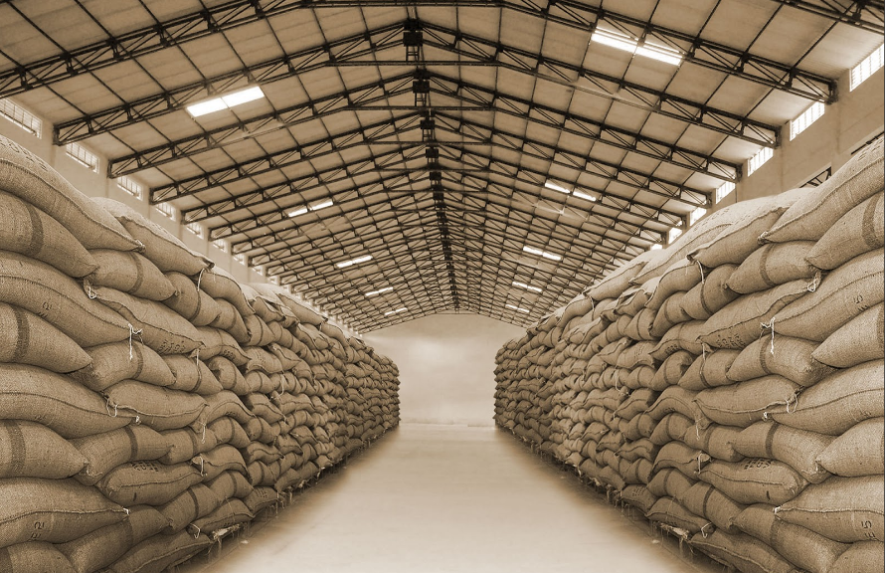
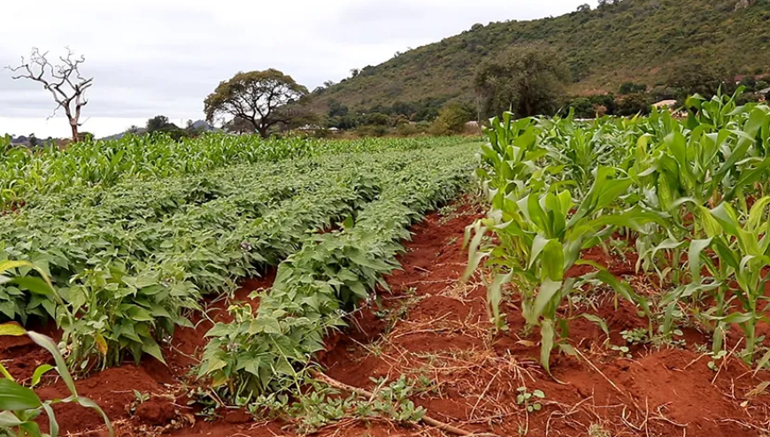
BENEFITS
Transportation
Storage
Mixed Farming

Slide 8
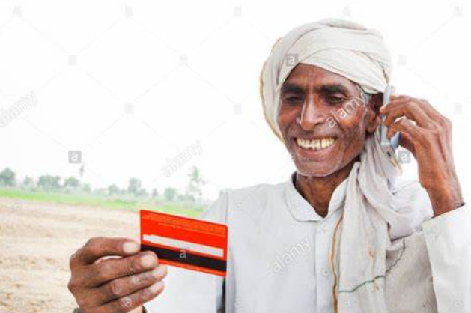
Uniqueness About Our Product & Service
Fresh vegetables to be sold
Residulas of bio gas to be used as fertilizer which enhances soil fertility
Soil testing is done before planting seed
Concession for farmers who purchases crops from our shop ,Id card is must.

Slide 9

Building a A Team
Human Resource Department
Legal Team
Technical Department
Employees
Transportation
Marketing

Slide 10

Funding the Growth / Scalability
Making growth more cost-efficient
Financing growth from profits
Attracting investors

Slide 11

Startup India Scheme
Must be a private limited company or a limited liability partnership
Approval from the Department of Industrial Policy and Promotion (DIPP)
New firm and not older than five years turnover of the company should not exceed 25 crores
Startup India Seed Fund Scheme 2022
20lakh grants , 50 lakh debt

Slide 12

Benefits of Startup India Scheme
Tax Exemption
The startups registered under the Startup India scheme are exempted from tax.
This exemption is provided for a period of the initial three years

Slide 13
Business Loans for Startups by the Indian Government
Bank Credit Facilitation Scheme
The repayment tenure of the scheme ranges between 5 years and 7 years but in special cases, it can be extended up to 11 years
Pradhan Mantri Mudra Yojana (PMMY)
Ranging between Rs.50,000 and Rs.10 lakh
Sustainable Finance Scheme
Loans ranging between Rs.10 lakh and Rs.1 crore can be availed
Repayment of loans seven years

Slide 14
MARKETING STRATEGIES

Slide 15



CAMPAIGN
TALKS
REFERRAL PROGRAMS
PAMPHLET

Slide 16



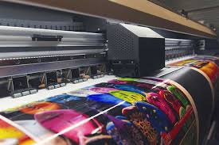
ADVERTISEMENT
RUNNING ADS
WEBSITE ADS
SOCIAL MEDIA ADS
BANNERS

Slide 17

Find a brand personality
A brand must have a personality, i.e. a set of distinctive features, for example, in communications, relations with consumers
It’s easier for a brand with an established personality to fight for the attention of the customer.

Slide 18
Legal Matters:
Registration of a business entity: The first step is deciding the business structure and registering it. Some of the common business entities are Sole Proprietorship, One Person Company, Limited Liability Partnership, Partnership Firm, Private limited company, and Public limited company.
Name: One of the most important steps is deciding the name of the business as it reflects the vision of the business. Check to see if the name you selected hasn’t been claimed by another entity.

Slide 19
Founders Agreement:
Creating a founder’s agreement containing all the details regarding founding members of a business is a solid foundation of the business. As a result, the document serves as a contract that legally establishes the founders’ and company’s rights, ownership, obligations, dispute resolution, and other aspects.
Documents:
The first step is to ensure that all of the necessary documents for registration are in order. Setting up a business in India necessitates a plethora of legal requirements and documentation.

Slide 20
Legal licenses and registrations:
To conduct and run the business, there are few registrations and licenses required. Some of the general registrations include Shops and Establishments License, Permanent Account Number, GST registration, Income Tax registration, Bank Account, etc.
Process in Registering our company:
Take Permission grama panchayath or Corporation (2-3 days time)
If selling product in own shop, Door number of our shop & permission from panchayat.
If we are selling in rented shop Their door number should be there.
Adhar card details, Land Records are must for this.

Slide 21
Requirement for Taking a Bank Loan
Adhar
Bank Account
2 witness sign (Surity)
Land Record
Plan Estimation(Our Plan)
Loan Form Filling

Slide 22
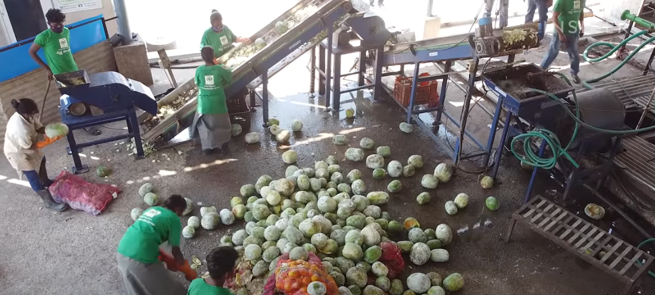
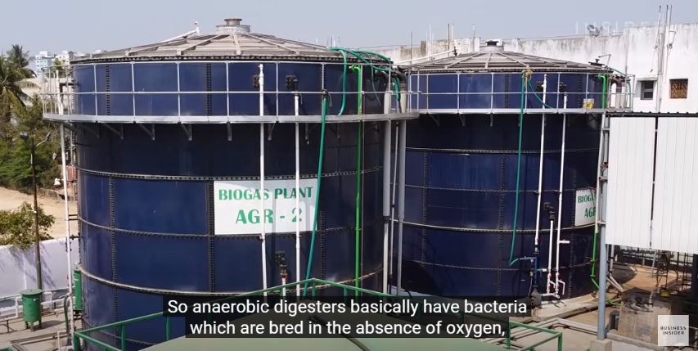
Exploring Secondary Sources of Revenue
BIO GAS
Another byproduct of bio gas is fertilizer

Slide 23
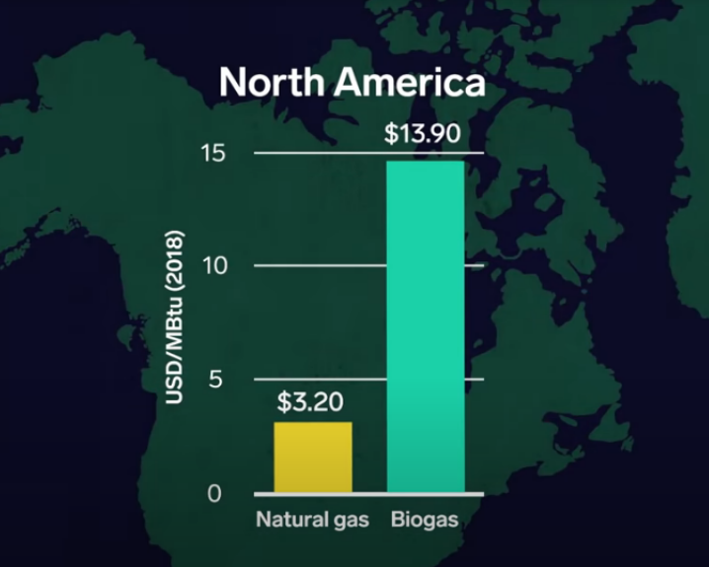
Price of Bio Gas

Slide 24

Mentorship and Seeking Support
Mentor:
Mentors can be key to your business’s success by giving you insights from those who did it before you.
You'll receive guidance based on real-world experience, connections to other advisors, and physical resources from your mentors to aid in your development.

Slide 25
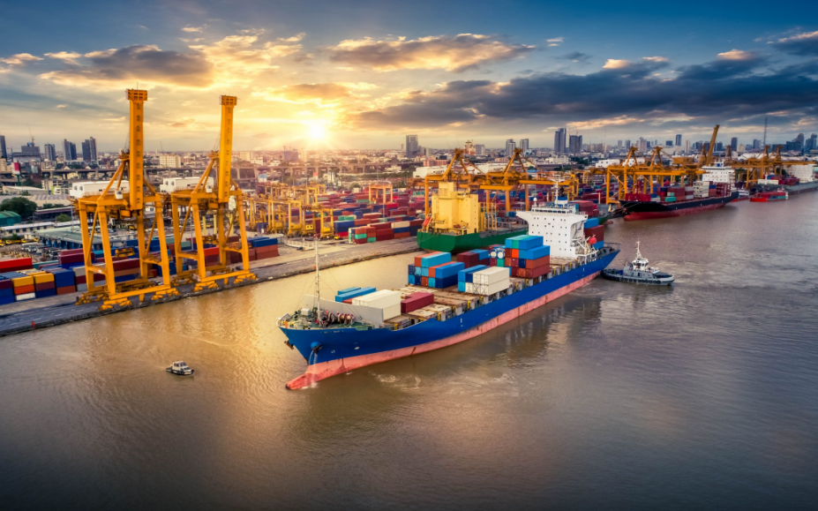
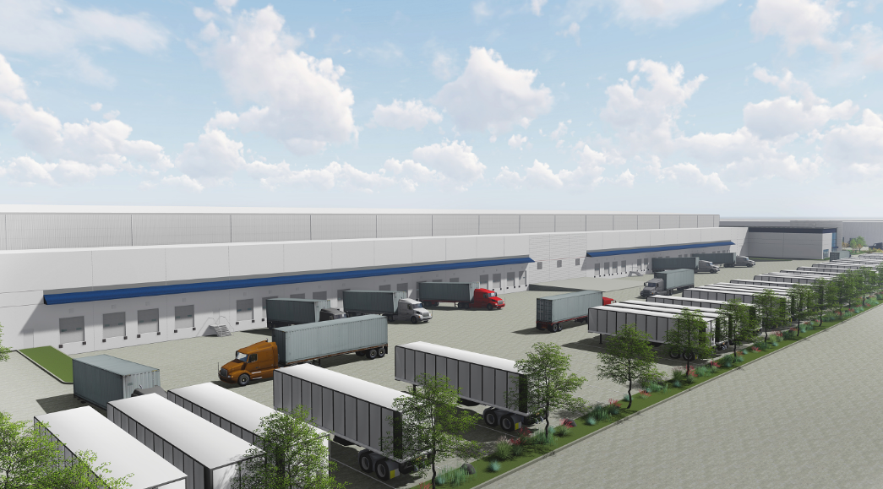
FUTURE PLANS
Exporting
Cold Storage Plant

Slide 26
THANK YOU

